Slide 1


UCD MSc Clinical Nutrition and Dietetics Practice Educator Training 2025
UCD Dietetics Practice Education Team
Contact: mscdietetics@ucd.ie
https://www.ucd.ie/phpss/about/subjectareas/clinicalnutritionanddietetics/practiceeducationplacements/practiceeducatorsresources/
Notes:
Welcome to training for dietitian practice educators for practice placement 2 2025. This session is being recorded.
As an approved dietetic education provider UCD is required by CORU to provide training on practice placement education to practice educators. This resource is aimed at all CORU RD’s in hospital settings who train and assess UCD student dietitians in practice placement 2 in 2025, regardless of their level of training experience. It will take roughly 25mins.
A certificate of completion will be provided on completion upon request.

Slide 2
Overview
1. Expectations of you as a practice educator.
2. Providing feedback and assessment of students.
3. Discuss the CORU required mechanism of return of placement assessments to UCD.
Notes:
In today’s session we will cover :
Available on the UCD Dietetics practice education placement website, within practice educator resources you will find an introductory training session which covers:
The UCD Practice Education team and be aware of how to contact us.
The academic and placement structure of the UCD Masters in Clinical Nutrition and Dietetics.
The essential role that experiential learning, provided by practice placement, has in enabling student dietitians acquire CORU defined standards of proficiency.
UCD supports and how to access them e.g. practice tutors, practice education manual etc.

Slide 3
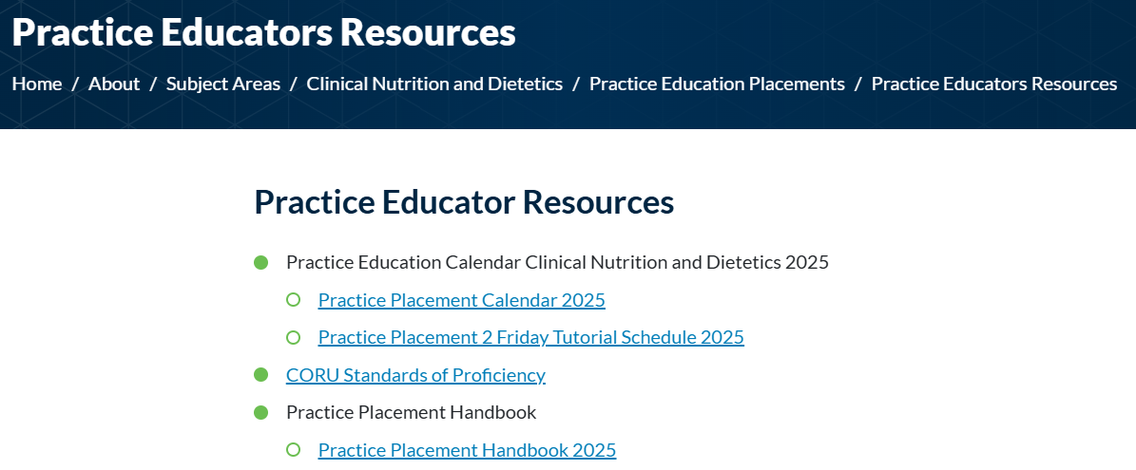
Practice Educator Responsibilities
Orientation/induction
Teaching & supervision
Provision of feedback
Assessment of competence
Notes:
The practice placement handbook provides significant detail on the responsibilities and practicalities of placement, before, during and after for you, the student, the tutor and UCD. It is available on the practice education website in practice educator resources.
Broadly speaking the responsibilities of practice educators are: …
We will work through these in the following slides.

Slide 4
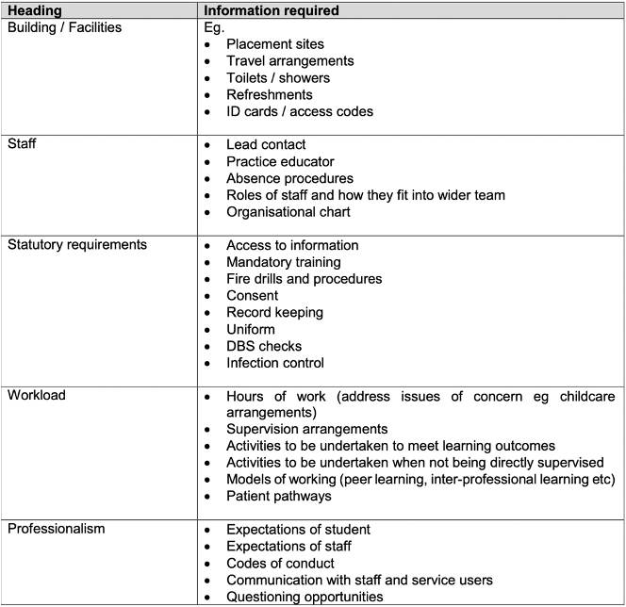

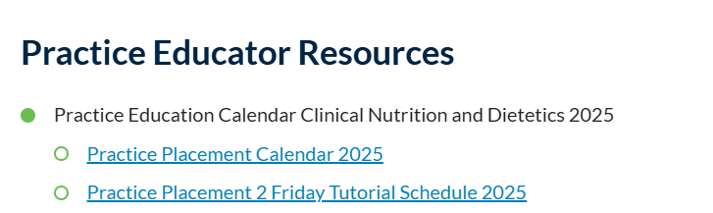
Induction and Orientation
“Local” policies & procedures
Requirements
Expectations
Systems & access
Meet and greet
Timetable
Notes:
It is for the site to decide how orientation/induction is done and by who. Providing the right induction can significantly influence how a student views and performs on practice education placement. If a student feels comfortable and adequately equipped with the information they require they are far more likely to succeed. Conversely, if a student feels unwelcome or ill-informed they may become nervous or defensive which will be to the detriment of both learner and associated staff. Examples are provided in the table but should be adapted according to the placement provider site
Where are students to base themselves? Somewhere secure to store personal belongings? Key fob, ID etc. Login/student access & data protection. Access to pc if required to write letters, access patient system and labs etc. Use of abbreviations? Writing medical chart notes? Negotiating IT systems, Catering systems.
Placement timetable. There should be no surprises for the students.
Timetabling should consider the week of placement and the learning priorities required of students.
At the beginning of the week students learning objectives should be reviewed with learning opportunities created in consultation between the PE and student. Feedback on the learning objectives should be given at the end of each week. Feedback between student and educators indicates that a “block” of time spent with 1 educator provides deeper learning for the student and facilitates the educator in providing relevant timely actionable feedback and meaningful assessment of their performance. In the event that a student is assigned to multiple educators over the course of a day or week, advance communication between the educators and the student is vital to ensure that expectations and learning is adapted. Otherwise it can become becomes very confusing for the student and a barrier to learning.
Students will return to UCD on most of the Friday’s of the placement unless there is a public holiday or during consolidation/preconsolidation. The calendar of dates is available on the website.

Slide 5
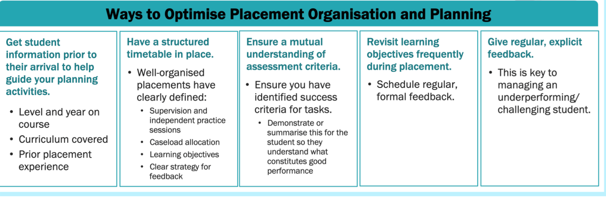
https://www.ucd.ie/phpss/about/subjectareas/clinicalnutritionanddietetics/practiceeducationplacements/practiceeducatorsresources/

Slide 6

Student Coordinator
-Key link between UCD and Dietetics Department.
-Co ordinates timetabling and consolidation.
-Co ordinates midway and final assessments.
-Co ordinates the returns of completed final assessments to UCD.
-Receives completed tutor visit forms.
-support practice educators.

Slide 7
Teaching & Supervision
Facilitates the gradual integration of theory with practice over 14 weeks
Experience and supervision is offered by Dietitian Educators in a supportive learning environment via a structured timetable
Teaching & supervision is student led
Notes:
At outset, each SC/PE will clearly explain performance expectations to the student cognisant of the stage of placement. Expectations from weeks 1-7 will be different to those from weeks 7-14.
Each PE should be aware of the reducing need of any student to shadow/observe as time passes with you. They should be active participants, learning by doing whenever possible.
There should be local procedures are in place and arrangements made in the event of the absence of a PE and a clear indication of who will assume the teaching role in their absence.

Slide 8
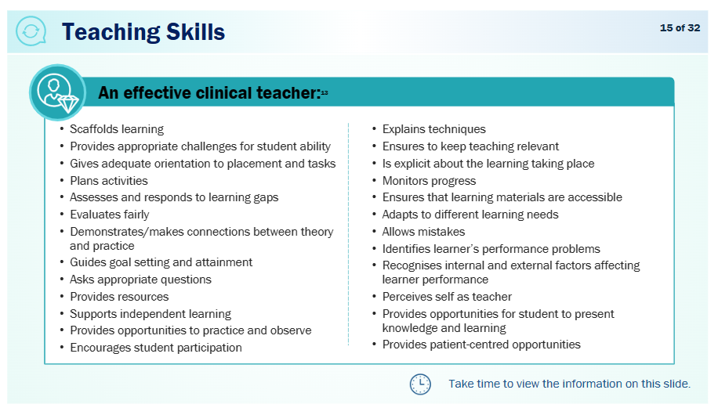
Tasks can be assigned

Slide 9
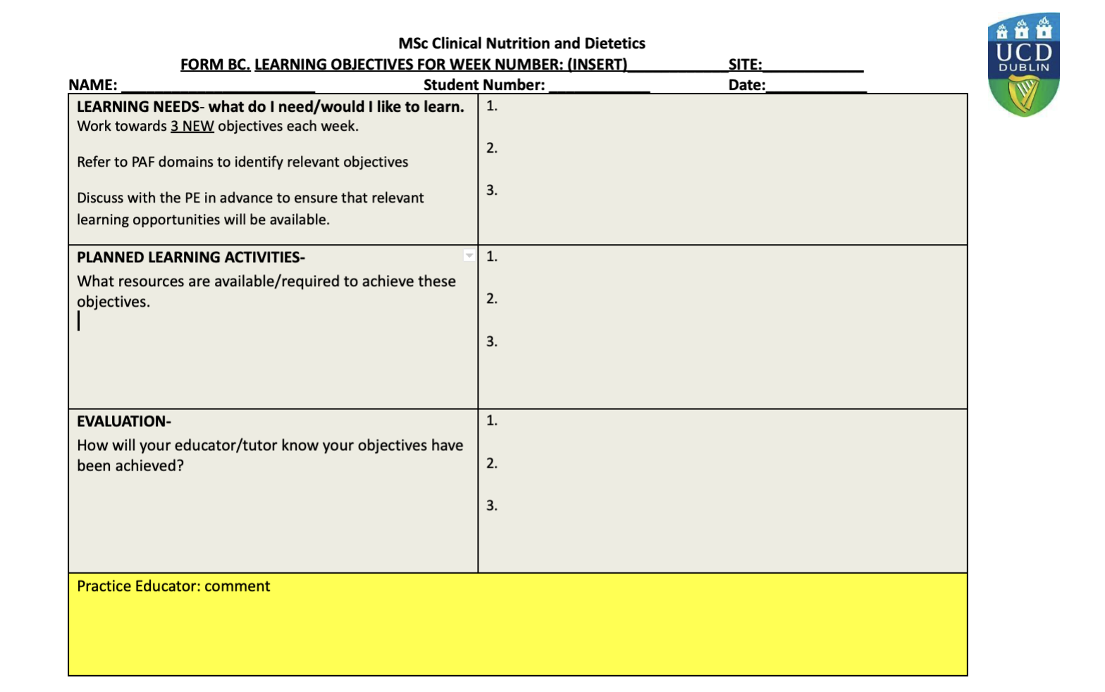
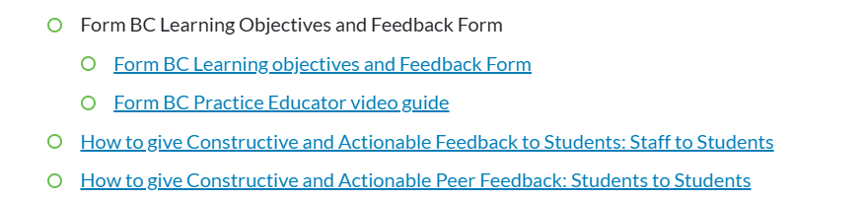
What is the Meaning of Student Led?
Notes:
Teaching is not required to be based on speciality but on the student attaining competence in terms of knowledge, skills and professional performance outlined in the assessment forms.
It should be led by the student in that they identify specific LO’s that they would like to achieve over a defined period of time while they are with you. These will be presented to you by the student on Form B, an example of the front of which is summarised above.
The LO’s are benchmarked against CORU’s SOP and map directly to the Assessment forms which I will cover soon.
You are asked to provide teaching and learning opportunities that will facilitate the student to achieve their LO or to renegotiate alternative LO’s in the event that T and L available will not address the student’s LO’s at that time.
PEs will support the student’s learning in assisting the student in setting objectives and suggesting planned learning activities in collaboration with the PT if required.

Slide 10
An example of a week
 | Morning | Afternoon |  | With PE: goal setting, feedback & assessment planning
Monday | Refer to your timetable. Discuss and agree Form BC Discuss PE expectations: start time, where to meet, hours per day, what feedback is required, knowledge requirement. Discuss student expectations: when feedback will be received/where. Agree time and place for Form BC review.
 |  |  |  | With PE/Tutor/Peer/Self: client centred dietetic related learning and activities
Tuesday | Tutor visit (try to identify an activity/task to practice)
Wednesday |  |  |  | With Tutor and Peers: consolidation of learning, Clinical reasoning & reflection practice. Peer review.
Thursday |  | Review BC & D. Get PE signatures!
 |  |  |  | Self directed time
Friday |  | Pre reading for next week. Insert relevant examples into PAF/PROF Add to portfolio content. Competence checklist-LO’s for next week.

Slide 11
Why is Feedback Important?
Feedback can help focus effort, so your energies are concentrated on where they're most needed.
Feedback is performance-enhancing. It can help you to improve the overall quality of your work or to reach a particular target or a standard that presents a real challenge.
Feedback is motivational. It's reassuring to know that you're doing OK, and great to have a pat on the back when you've done really well. And if you are in danger of falling behind, feedback can be a spur to taking prompt action.

Slide 12

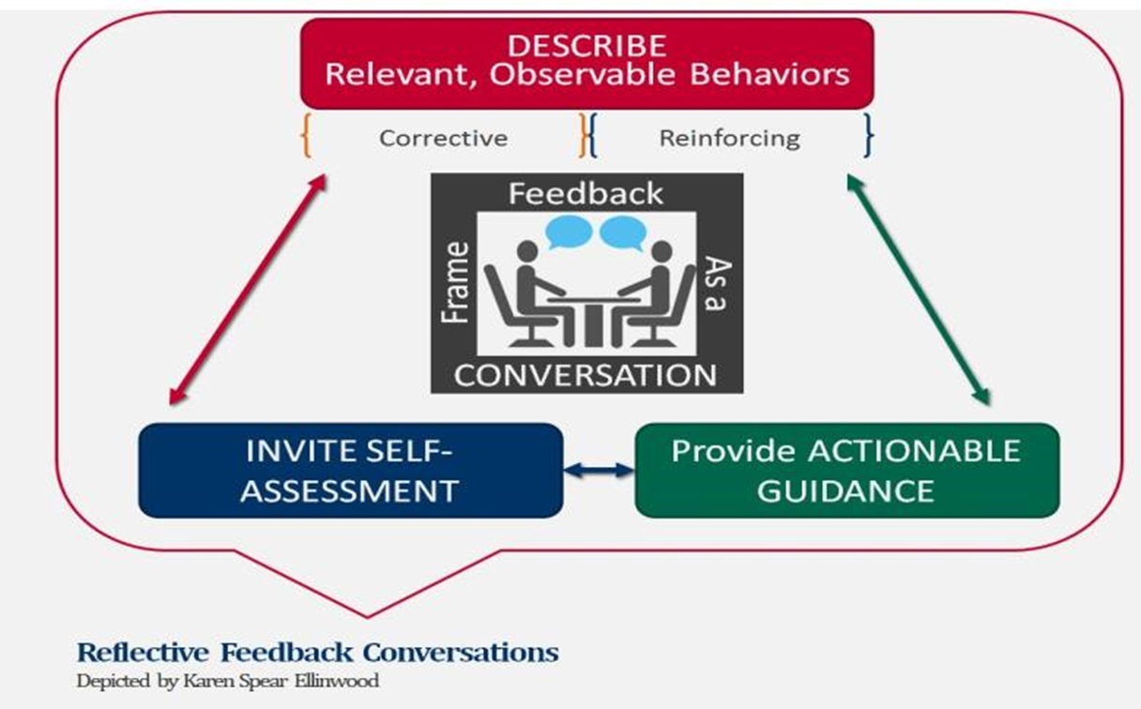
Reflective Feedback Conversations collaboratively constructed conversation about student performance or progress
Step 1. Learner states what was good about their performance
Step 2. Teacher states areas of agreement and elaborates on good performance
Step 3. Learner states what was not correct or could have been improved
Step 4. Teacher provides guidance on what he/she could have improved and how this could be done next time
Notes:
The key to making complimentary feedback (aka positive reinforcement) and corrective feedback constructive is a "description of relevant observable behaviors".
Step 1. Learner states what was good about their performance
Step 2. Teacher states areas of agreement and elaborates on good performance
Step 3. Learner states what was not correct or could have been improved
Step 4. Teacher provides guidance on what he/she could have improved and how this could be done next time

Slide 13
Tips for giving feedback
Be clear about what you are giving feedback on and link this to the learner’s overall professional development and/or learning outcomes.
Give feedback as soon after the event as possible.
Focus on the positive, yet include areas for improvement ( 3 stars and a wish)
Feedback needs to be given privately wherever possible, especially negative feedback.
Feedback needs to be part of the overall communication process and ‘developmental dialogue’. Use skills such as rapport or mirroring, developing respect and trust with the learner.
Stay in the ‘here and now’, don’t bring up old concerns or previous mistakes, unless this is to highlight a pattern of behaviours.
Focus on behaviours that can be changed, not personality traits.
Talk about and describe specific behaviours, giving examples where possible and do not evaluate or assume motives.
Notes:
Example of specific feedback received from non acute 2021 student: student and PE agreed on a system for giving feedback whereby we were first given feedback which was not essential or urgent but would help us to improve practice, followed by feedback which our educators felt we needed to implement to practice effectively and safely. They found this system to be really helpful.

Slide 14
Tips for giving feedback
Use ‘I’ and give your experience of the behaviour (‘When you said…, I thought that you were…’).
When giving negative feedback, suggest alternative behaviours.
Feedback is for the recipient, not the giver – be sensitive to the impact of your message.
Consider the content of the message, the process of giving feedback and the congruence between your verbal and non-verbal messages.
Encourage reflection. This will involve posing open questions such as:
Did it go as planned? If not why not?
If you were doing it again what would you do the same next time and what would you do differently? Why?
How did you feel during the session? How would you feel about doing it again?
What did you learn from this session?
Do not overload – identify two or three key messages that you summarise at the end.

Slide 15
Barriers to Effective Feedback
Hesketh and Laidlaw (2002) identify a number of barriers to giving effective feedback in the context of medical education:
  Fear of upsetting the trainee or damaging the student-practice educator relationship.
  Fear of doing more harm than good
  Trainee being resistant or defensive when receiving criticism. Poor handling of a reaction to negative feedback can result in feedback being disregarded thereafter
  Feedback being too general and not related to specific facts or observations
  Feedback not giving guidance on how to rectify behaviour
  Inconsistent feedback from multiple sources
  Lack of respect for the source of feedback

Slide 16
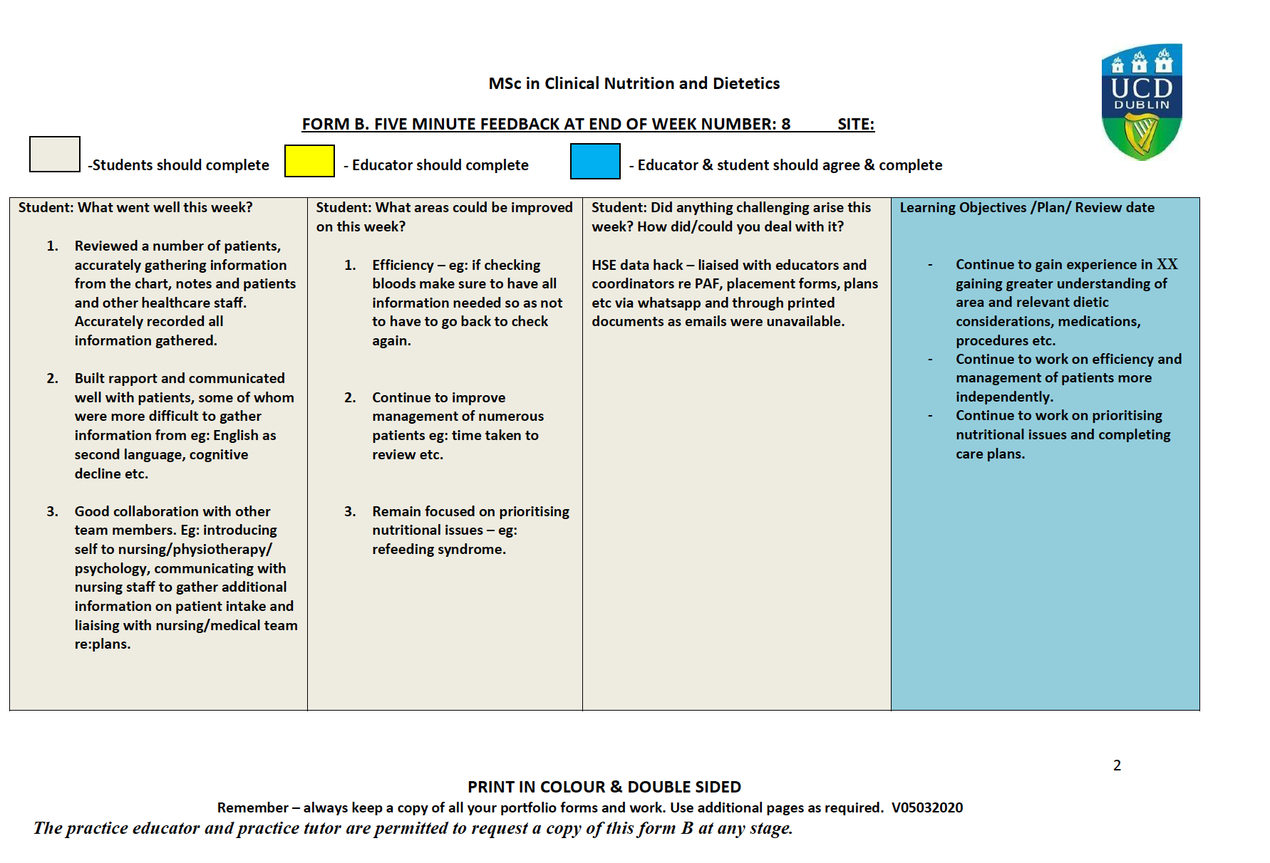
Notes:
The method that the student uses to gather feedback specific to their learning outcomes set at the beginning of the week is captured on the reverse of Form BC. Students will self identify what went well, areas for improvement and any challenges that arose. The PE will insert their feedback below the student evidence as shown in the next slide.

Slide 17
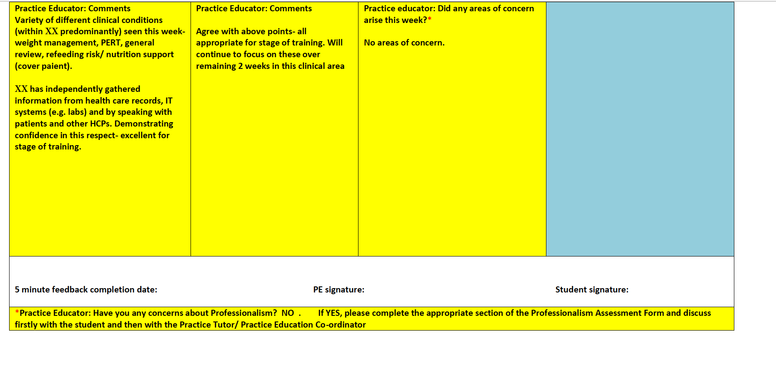
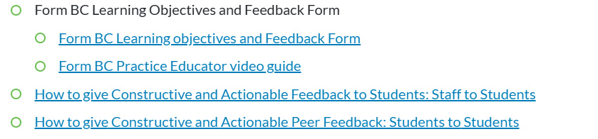
https://www.ucd.ie/phpss/about/subjectareas/clinicalnutritionanddietetics/practiceeducationplacements/practiceeducatorsresources/
Notes:
The PE will insert their feedback below the student evidence.
PEs will provide regular, structured teaching, supervision and actionable feedback to the student (5 minute feedback form) throughout the placement.
You may also be presented with an activity log Form C

Slide 18
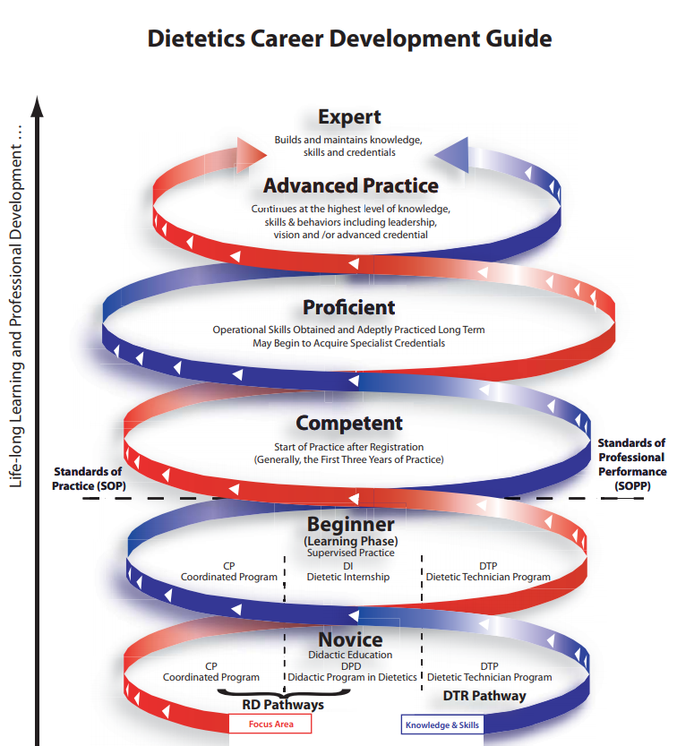
Assessing Learning and Defining Competence
1. The benchmark assessment of competence is not the same Standard of Practice against which Entry Level Dietitian’s/those on the register are measured.
2. Competence reflects the minimum threshold standards, minimum knowledge and minimum skills deemed necessary to ensure safe practice.
3. It’s what the student must know, must understand and must be able to do at the time they apply to join the Dietitian’s Register.
4. Ensures that the graduate is fit to practise.

Slide 19
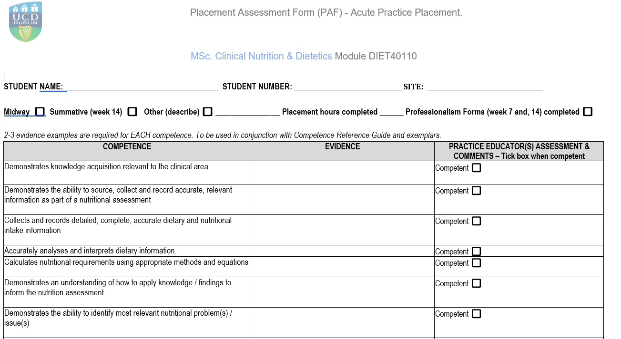
Notes:
UCD, UL and UCC have agreed common assessment terminology and criteria for assessing the SOP’s of students on placement as competences. In UCD these are presented in the format of Placement assessment form (PAF) and Professionalism assessment Form (PROF). Each form lists the competence the left hand column of the PAF and PROF forms. We assume that all students are not competent until ticked otherwise. Where evidence is not provided that competence cannot be assessed

Slide 20
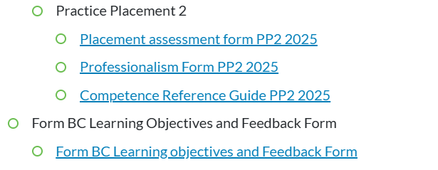
Assessing Competence
A student can be assessed as competent when they present relevant, adequate, accurate evidence.
A student must achieve competence in specific domains by midway assessment and in all domains by week 14 in order to pass placement.
Supporting resources:
https://www.ucd.ie/phpss/about/subjectareas/clinicalnutritionanddietetics/practiceeducationplacements/practiceeducatorsresources/
Notes:
Also exemplars on request.

Slide 21
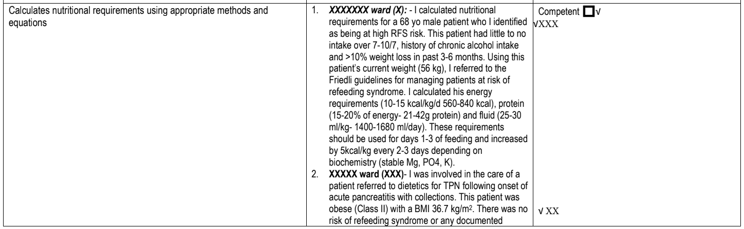
PAF exemplars are available on request
Midway PAF and Summative PAF required – 2 signatures. Educator or Coordinator must return to dietetics.admin@ucd.ie
Notes:
This is an extract from a summative PAF which demonstrates PE assessed competence when calculating nutritional requirements. 2 PAFS are required per student. One at the midpoint where week 7 competences must be achieved. one at the end where all competences must be achieved. Students are expected to continually add to their PAF/PROF on an ongoing basis. Each PE should comment on the evidence a student provides relevant to their time spent with you. however the midway, summative PAFS and the week 5, 10, 14 PROF will require the oversight of the SC. Sign off from a minimum of 2 is required for these assessments: signatures can come from any combination of PE SC or PT

Slide 22
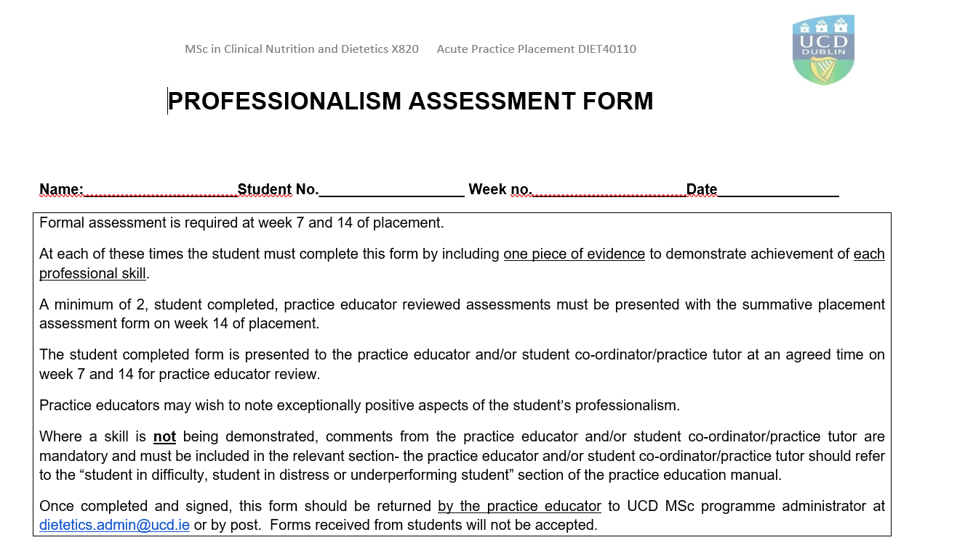
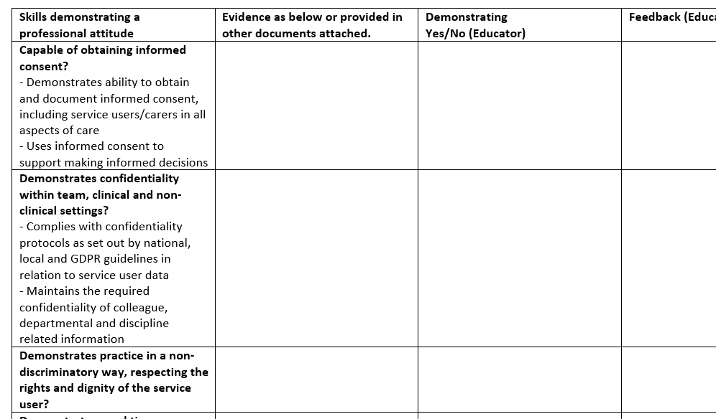
Educator or Coordinator must return to dietetics.admin@ucd.ie
Notes:
2 PROFs per student are required. It is expected that in each of the 2 forms that the student will provide one piece of evidence for each domain. A student must be assessed as yes in all domains in each of 2 forms in order to pass placement . PROF exemplars are also available on request.
Will every practice educator be required to assess an entire PAF or PROF? Not usually. They can only assess the evidence presented to them at the time.
Where a PROF competence is not being demonstrated, comments from the practice educator and/or student co-ordinator/practice tutor are mandatory and must be included in the relevant section- the practice educator and/or student co-ordinator/practice tutor should refer to the “student in difficulty, student in distress or underperforming student” section of the practice education manual.
The section for educator feedback is for voluntary comments.
PEs should inform the SC and PT at the earliest opportunity if there is any concern about the student’s ability to fulfil the practice education learning objectives, any breach of safety or professionalism or an ‘underperformance’ that requires a ‘Risk of Failure’ form (FORM J) to be issued during the practice placement. The ‘risk of failure’ form identifies areas for the student to work on within an agreed timeframe.

Slide 23
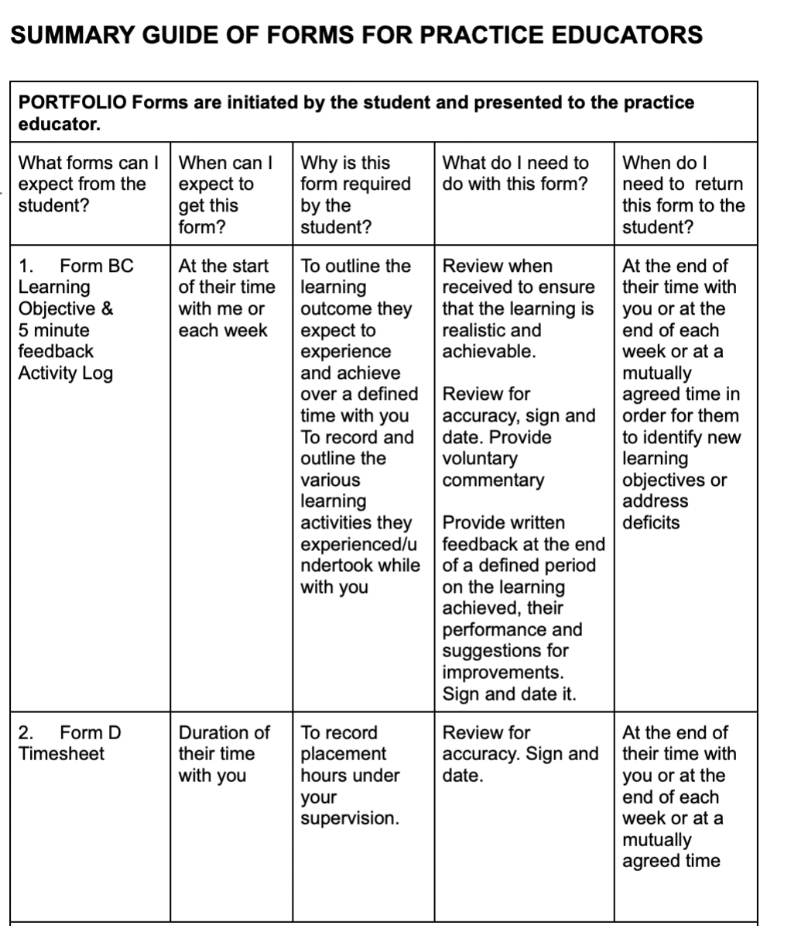

Slide 24

Supporting an underperforming/distressed student
Despite orientation, teaching, supervision and feedback there may be signs of*:
Not seeking/acting on feedback
No progression of learning
Requires repeated prompting/reminding
Poor personal/professional accountability
Sudden changes in behaviour/emotions
Sudden change in performance, motivation, participation
Repeated requests for special considerations
Being unusually demanding of PE time
Inability to communicate clearly
The above list contains examples and is not exhaustive

Slide 25
Supporting an underperforming/distressed student
1. As soon as practically possible after noticing signs, a minimum of 2 practice educators (one of which should be the Student Coordinator) should agree and confirm that the student is underperforming/distressed.
2. Meet with the student in a private and calm setting, making it clear to the student how much time is available for the meeting.
3. State concerns openly in a non-judgemental way e.g. “I’m concerned about you and would like to try to help”.
4. Gather the student’s account (being listened to and feeling understood may be enough to resolve some issues).
5. Try to assist the student’s identification and articulation of the main issue(s) and decide together on the most appropriate way forward. This may involve offering practical support such as a deadline.
6. Advise the UCD Practice Tutor if not already involved.
7. Request and complete Portfolio Form K-Risk of Failure if required.

Slide 26
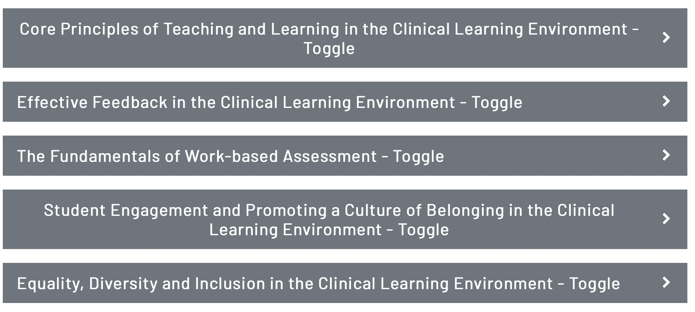

National Teaching and Learning Forum
https://my.opencourses.ie/course/view.php?id=96

Slide 27

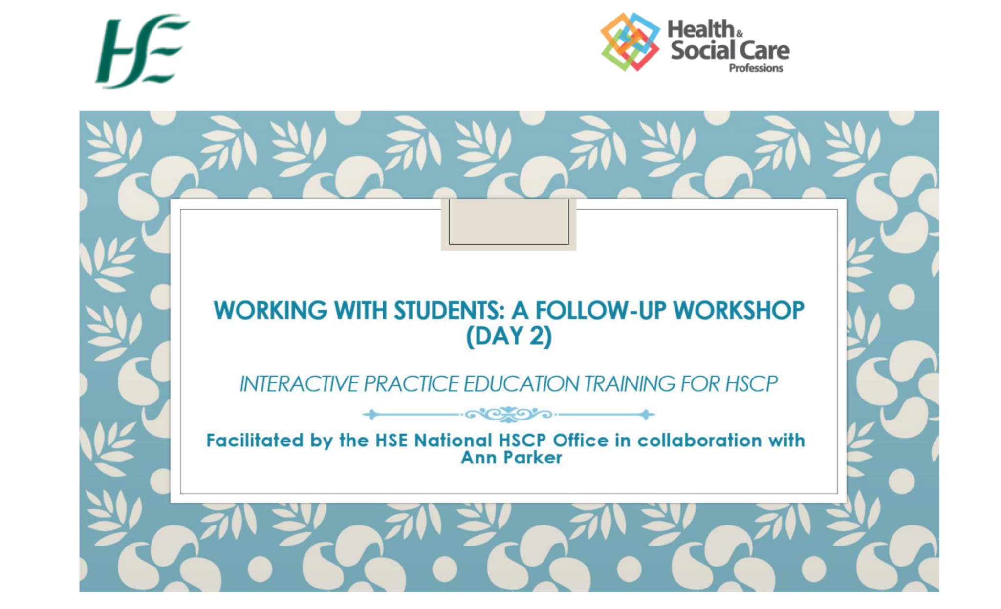
HSE HSCP Office
Please consider lobbying the following to obtain further training: HSCP.NationalOffice@hse.ie
Sinéad Fitzpatrick| HSCP Development Manager| National Health & Social Care Professions Office |HSE| Office of the Chief Clinical Officer| Phoenix Hall, St Mary’s Campus, Phoenix Park, Dublin 20. D20 CK33| & Clinical & Administration Block A, HSE Merlin Park Hospital|Galway H91 N973
Phone: 087 0985658| E-mail: sinead.fitzpatrick2@hse.ie | HSCP hub on HSELanD www.hseland.ie

Slide 28

Tutor support
UCD Practice Tutors are CORU Registered Dietitians.
Support for you and your site:
Ensuring that sites have the necessary information packs, curriculum information and assessment tools required.
Providing guidance and support to PE’s in enhancing the environment for student education.
Providing training, advice, support and assistance to PE’s in the assessment of student’s performance.
Assisting PE’s in the completion of student assessment forms.
Facilitating effective communication and working relationships.
Support for students include:
Ensuring student learning contracts/practice placement objectives are agreed at the start of each placement.
Supporting and facilitating shared learning experiences
Participation as required in practice placement supervision of students
Contributing to ongoing feedback to students about their performance
Facilitating effective learning within practice
Notes:
Nicola Dervan, Annelie Shaw, Ruth Charles. Joan Mahon also provides sessional support.

Slide 29
This is the end of the session.
Initial content was developed by Ruth Charles, Nicola Dervan and Annelie Shaw, Registered Dietitians and UCD Practice Placement Tutors.
Content has been amended in accordance with changes in regulatory requirements as defined by CORU and in conjunction with feedback we receive from students and practice educators on a yearly basis.
Every effort has been made to ensure that the content is accurate as of this date: Jan 2025.
If you require any further assistance around practice placement, please contact us at mscdietetics@ucd.ie outlining your requirements.

